Slide 1




SasView : A Small Angle Scattering Analysis Software Package
Andrew Jackson, European Spallation Source
on behalf of the SasView Collaboration
Grenoble, 3rd April 2017

Slide 2
Analysis Software - Who’s Job is it Anyway?
Analysis is where the science is → the USER’S JOB
Scattering is a tool and part of providing the tool should be analysis tools → the FACILITY’S JOB
Data on disk is useless to EVERYBODY

Slide 3
Analysis Software - Who’s Job is it Anyway?
But … where are the resources?
More pressing tasks for all of us : maintaining & improving instrumentation, bringing in and supporting users, dealing with instrument control and data reduction software …
Data Analysis is bottom of the heap …
… need to pool resources.

Slide 4



A little history …
Where did SasView come from?
DANSE project output
~ 8.5% of funds were for SANS
Kickoff meeting August 2006
Heritage: NIST IGOR macros

Slide 5
Continuity …
NIST Supported initial transition from NSF funding

Slide 6
Expansion …
NIST Supported initial transition from NSF funding
Now 8 active facilities
ORNL, ISIS, NIST, ESS, ILL, TUD/RID, ANSTO and Diamond
SINE2020 Funding at ESS
First major investment since DANSE
http://sine2020.eu

Slide 7
Development Model
Open, Collaborative, Community Development
Code is open source and publicly hosted at Github
Bug and Enhancement Ticket System - Trac
Bi-weekly developer calls
Code Camps
1st at NIST April 2013
2nd at ISIS April 2014
3rd at ESS Feb 2015
4th at TU Delft/RID March 2016
5th at ORNL October 2016
6th at ILL/ESRF April 2017
5 Year Roadmap
http://www.sasview.org
http://github.com/SasView

Slide 8
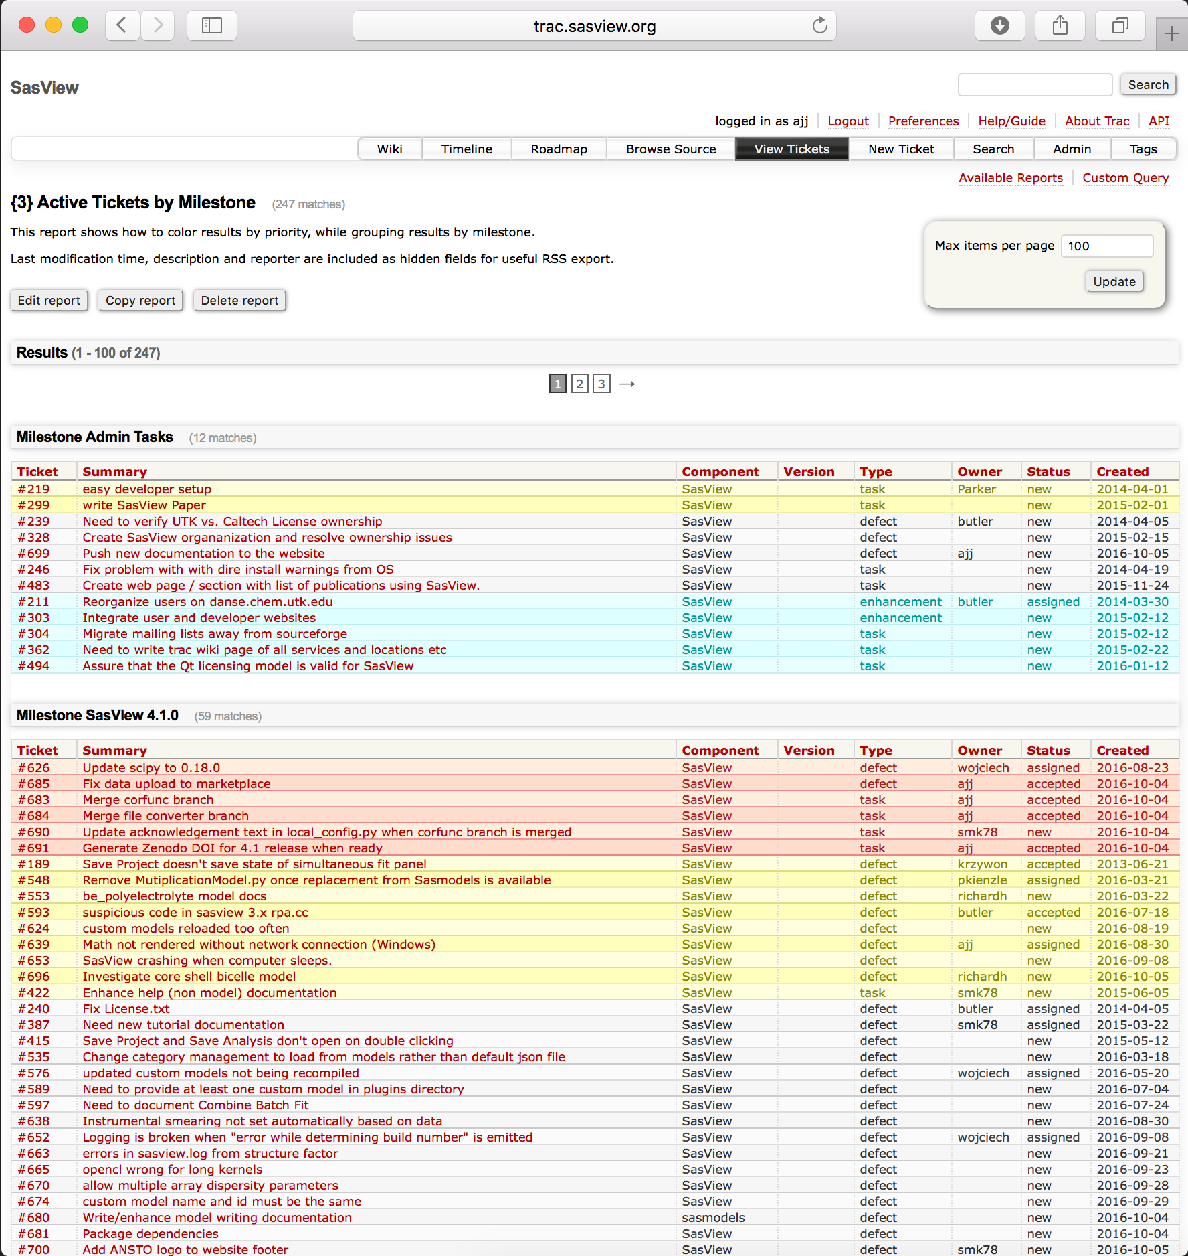
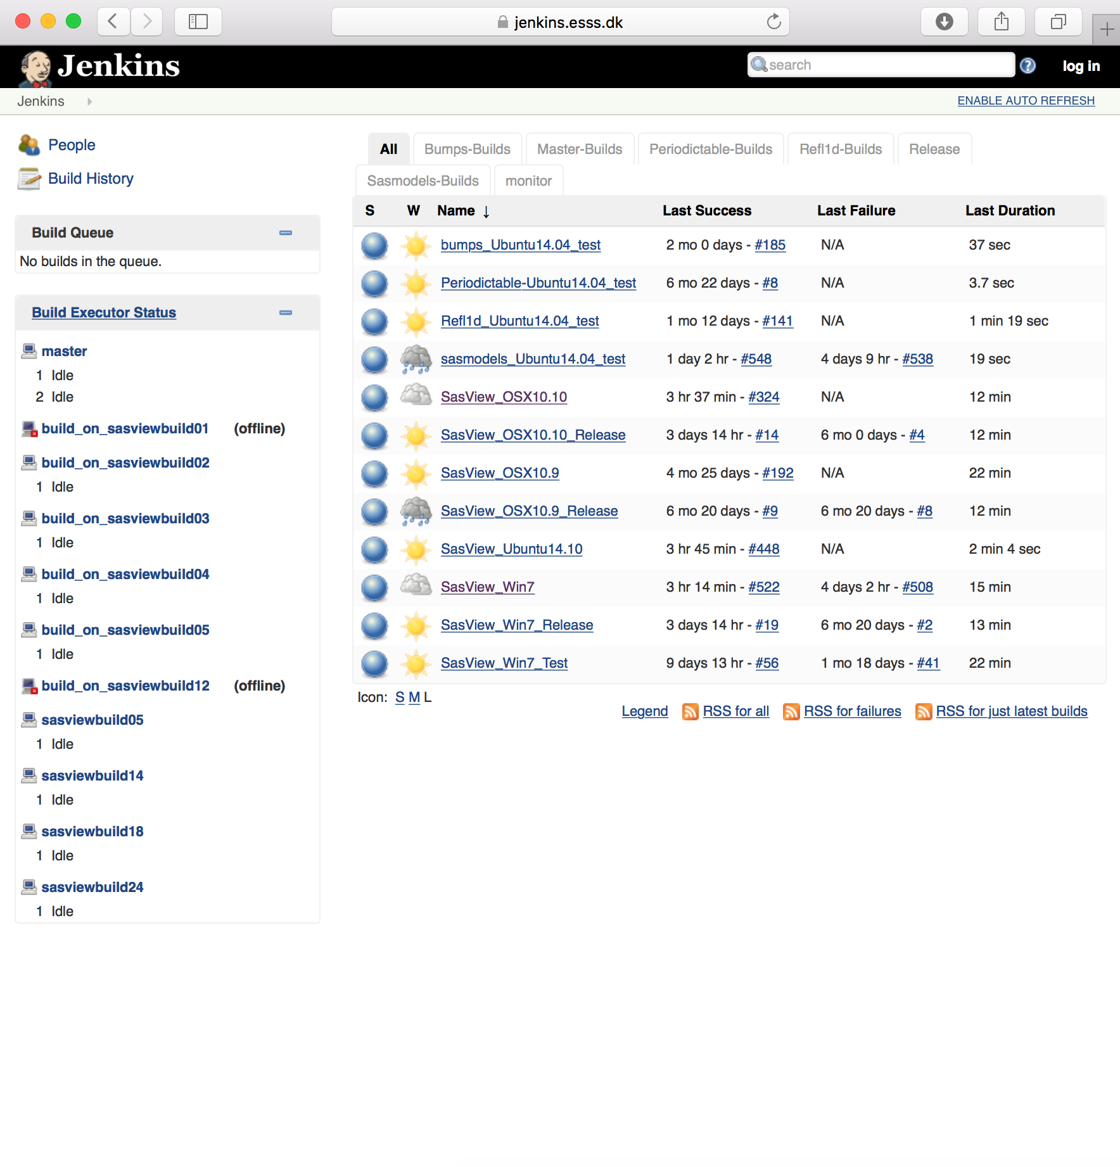
Development Model
www.sasview.org
Task and bug tracking trac.sasview.org
Automated Builds
build.sasview.org
Hosted by UT
Hosted by ESS

Slide 9
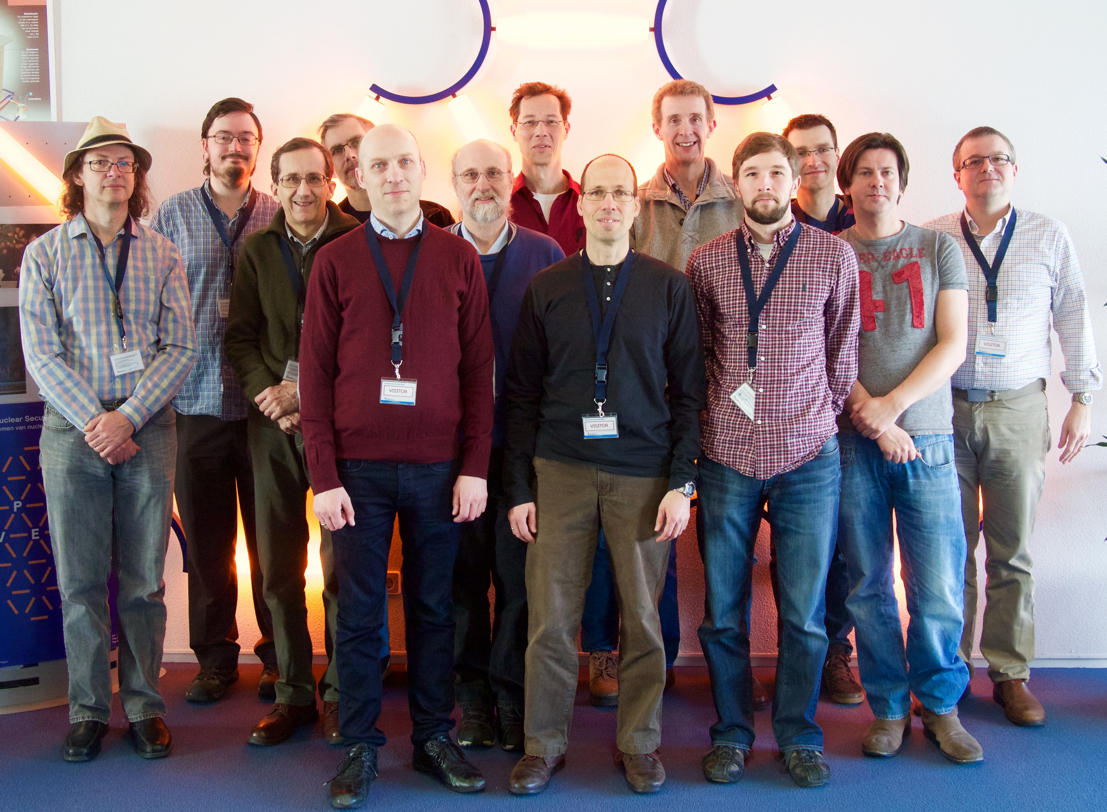
Current Development Team
Paul Butler (NIST)
Mathieu Doucet (ORNL)
Andrew Jackson (ESS)
Steve King (STFC)
Jurrian Bakker (TUD)
Wim Bouwman (TUD)
Miguel Gonzales (ILL)
Richard Heenan (STFC)
Dirk Honecker (ILL)
Paul Kienzle (NIST)
Jeff Kryzwon (NIST)
Ricardo Leal (ORNL)
David Mannicke (ANSTO)
Andrew Nelson (ANSTO)
Torben Nielsen (ESS)
Lewis O’Driscoll (STFC)
Steve Parnell (TUD)
Wojciech Potrzebowski (ESS)
Piotr Rozyczko (ESS)
Tim Snow (Diamond)
Adam Washington (STFC)
Delft
ORNL
and thanks to the many previous contributors, particularly Jae Hie Cho and Alina Gervaise

Slide 10
What Can SasView Do Currently?

Slide 11
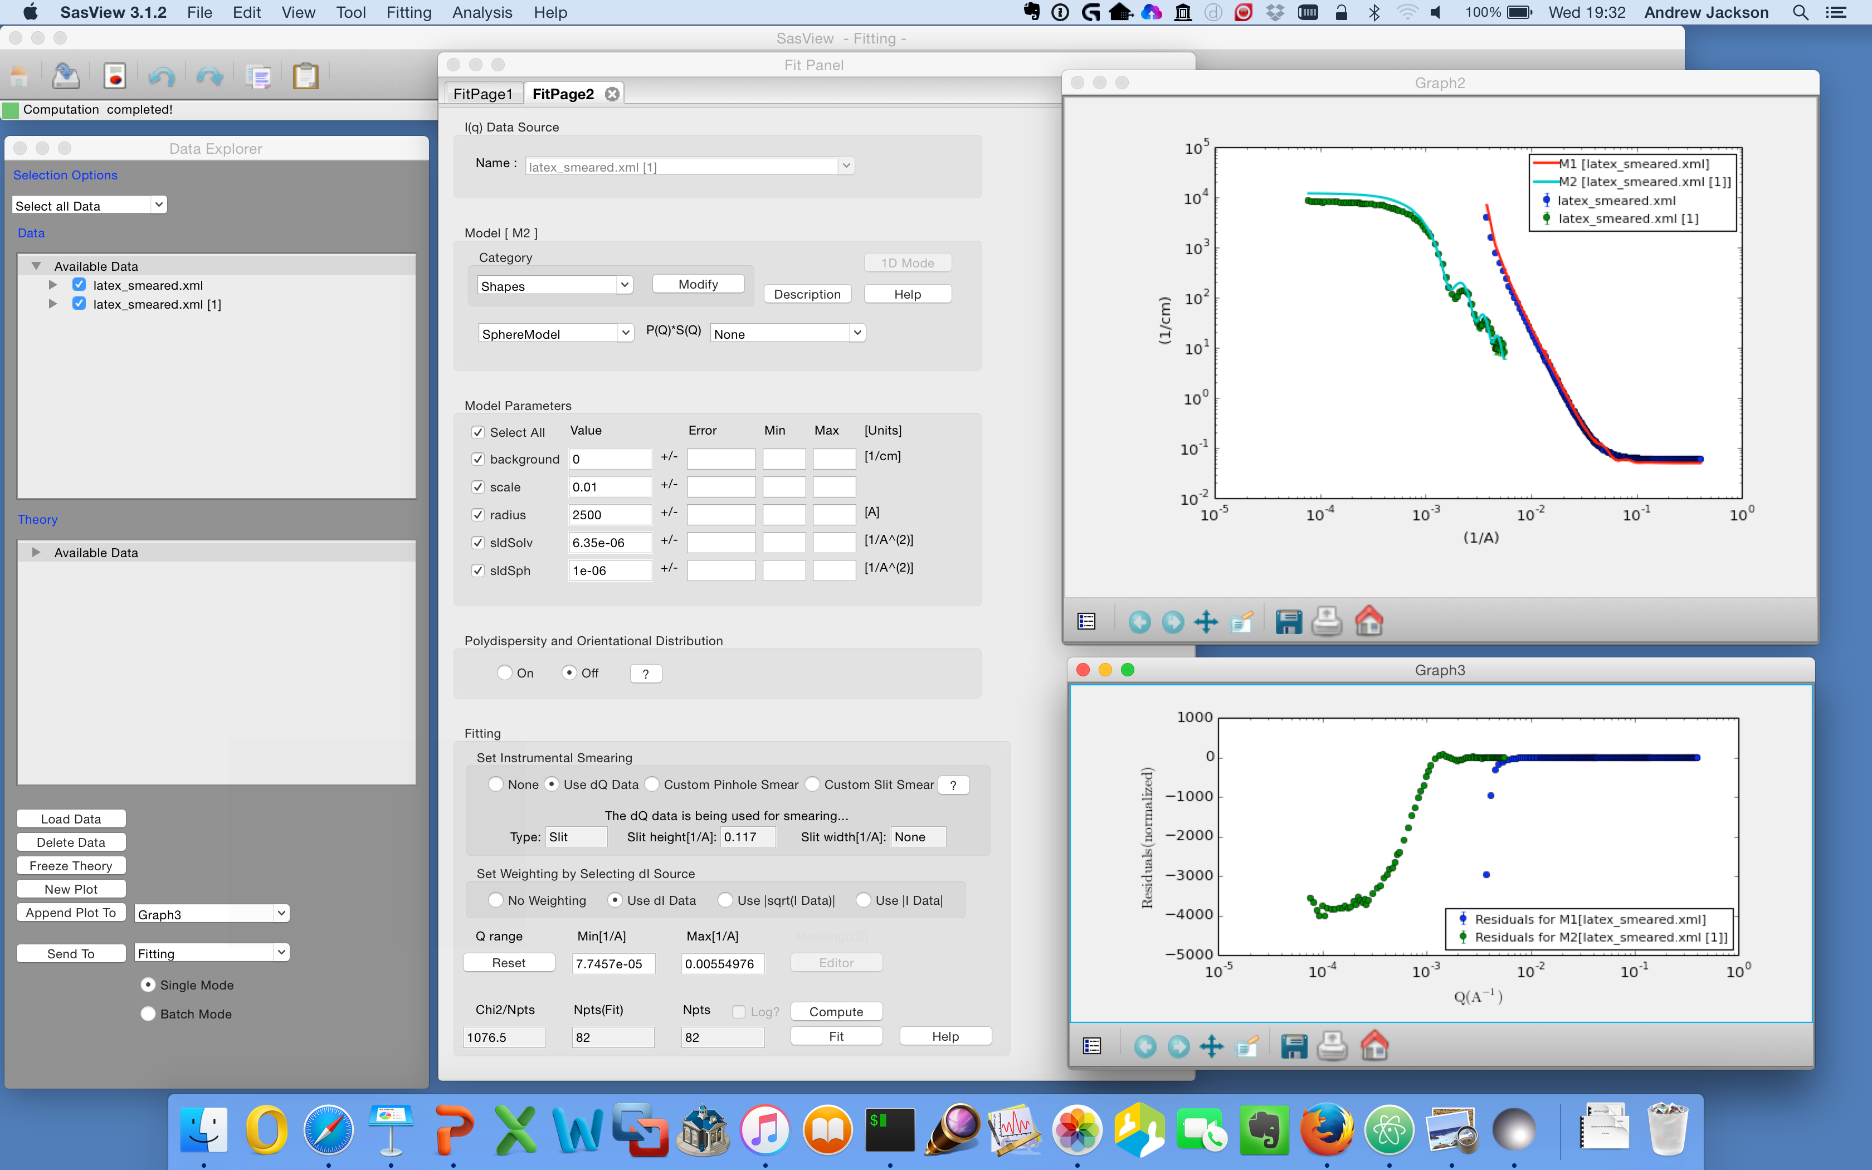
1D Analysis

Slide 12
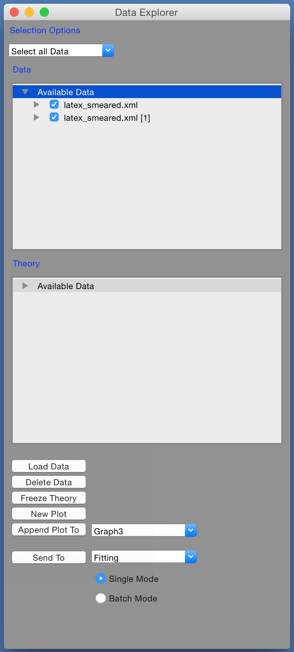
1D Analysis
Load Data …
Select Data Sets …
Here we have SANS & USANS from latex spheres
Send to Fitting …

Slide 13
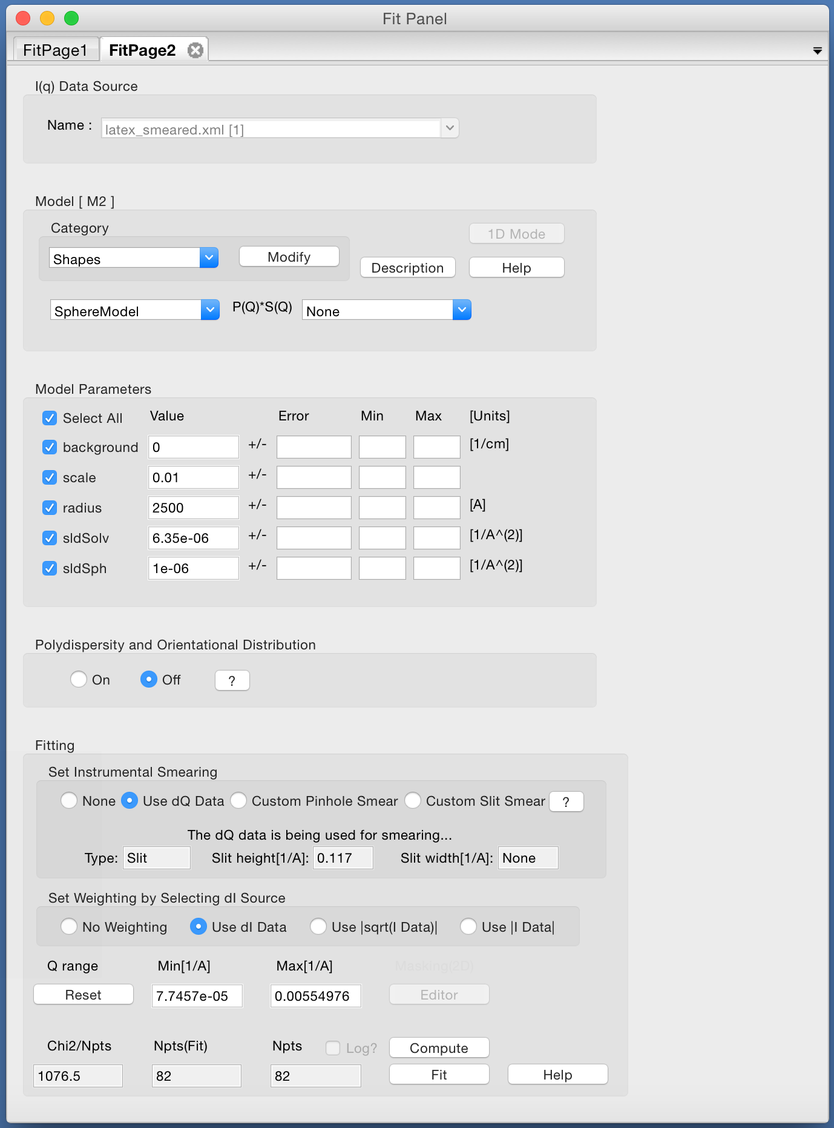
1D Analysis
Send to fitting …
Select a model …

Slide 14
1D Analysis
Send to fitting …
Select a model …
Set parameters …

Slide 15
1D Analysis
Send to fitting …
Select a model …
Set parameters …
Use resolution …

Slide 16
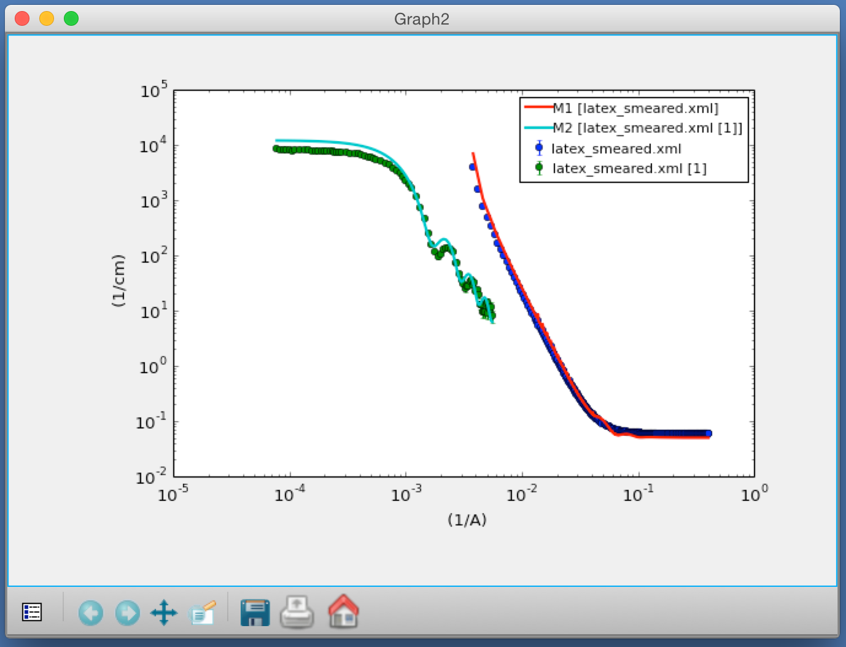
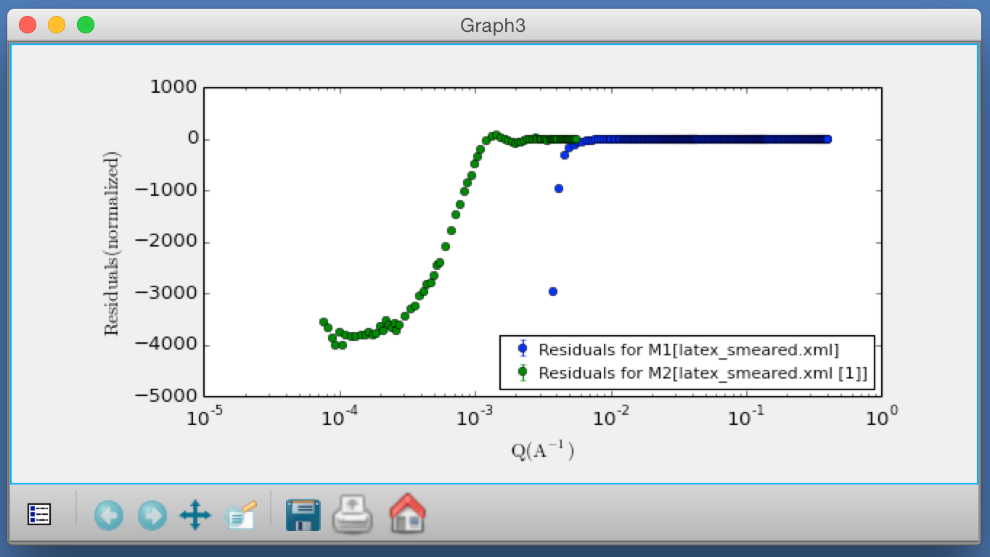
1D Analysis
Send to fitting …
Select a model …
Set parameters …
Use resolution …
How does it look?

Slide 17
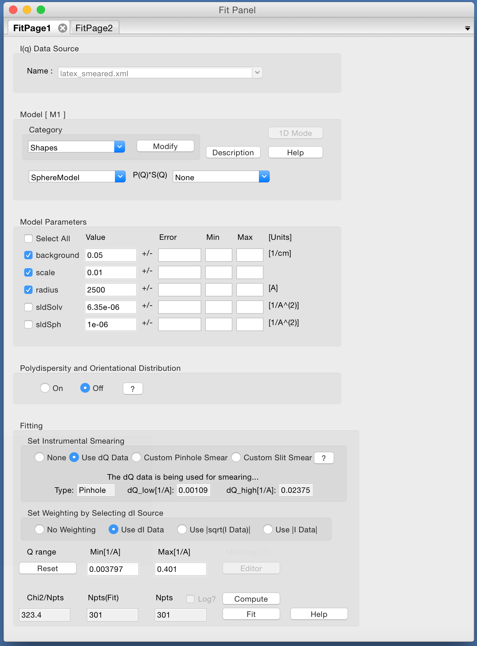
1D Analysis
Choose which parameters to fit …

Slide 18
1D Analysis
Choose which parameters to fit …
… and press the Fit button!

Slide 19
Constraints / Simultaneous Fit
But wait! We have two data sets of the same sample : SANS + USANS …

Slide 20
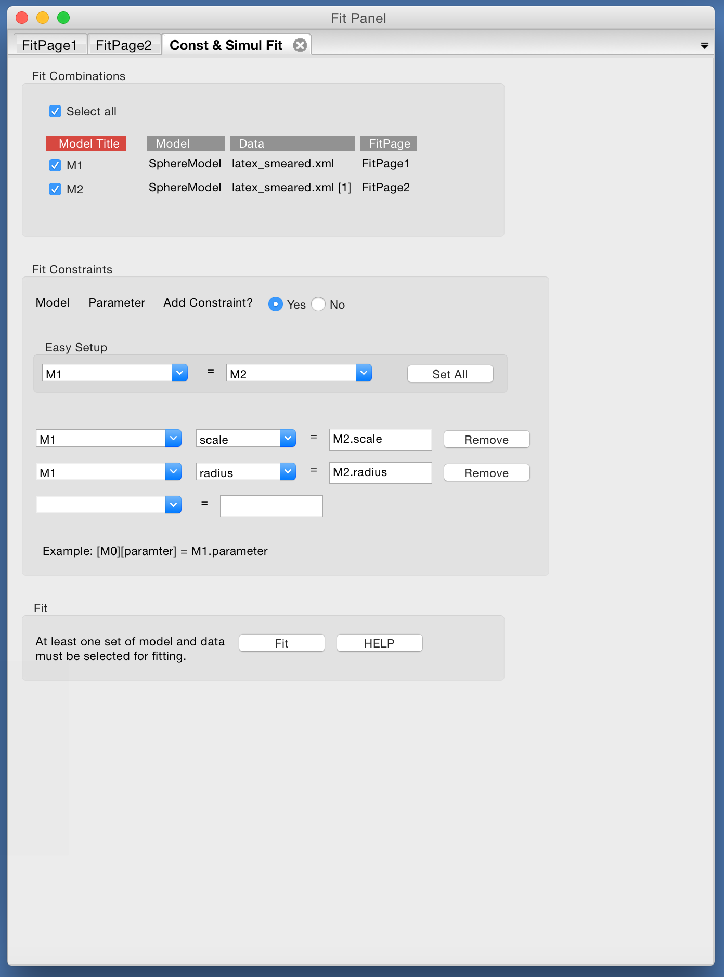
Constraints / Simultaneous Fit
But wait! We have two data sets of the same sample : SANS + USANS …
Set up a simultaneous fit …

Slide 21
Constraints / Simultaneous Fit
But wait! We have two data sets of the same sample : SANS + USANS …
Set up a simultaneous fit …
… with constraints

Slide 22
Constraints / Simultaneous Fit
But wait! We have two data sets of the same sample : SANS + USANS …
Set up a simultaneous fit …
… with constraints
Now press the Fit button!

Slide 23
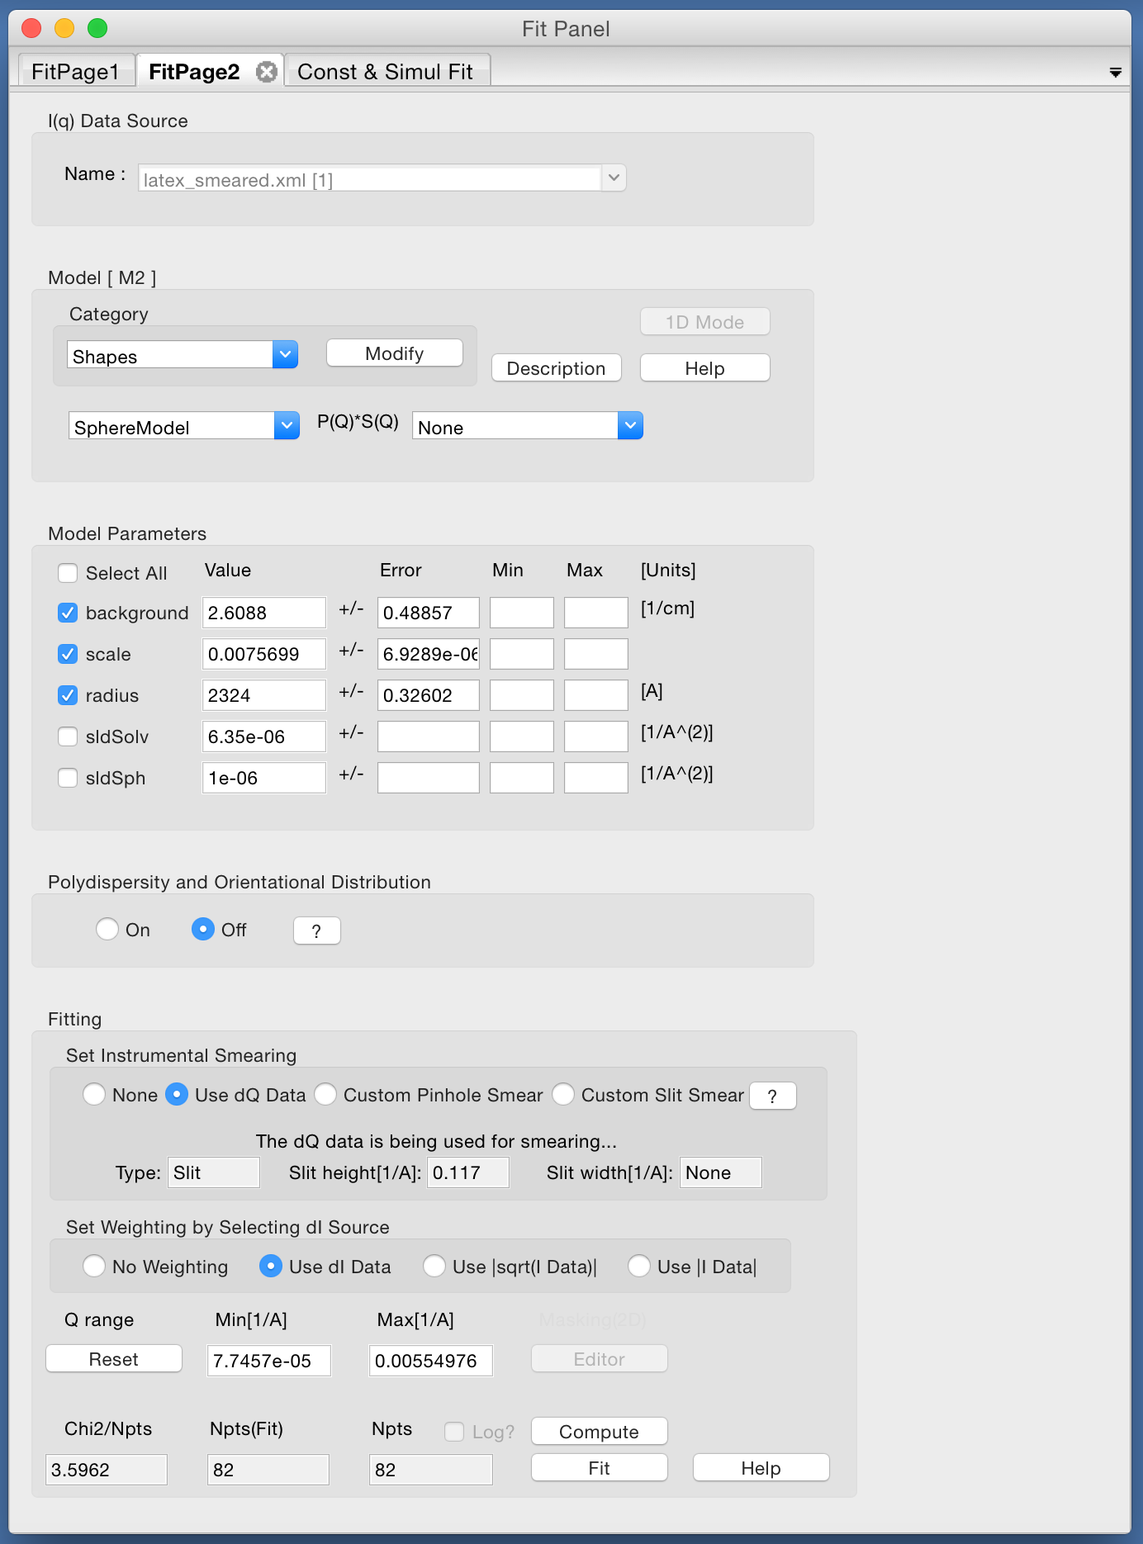
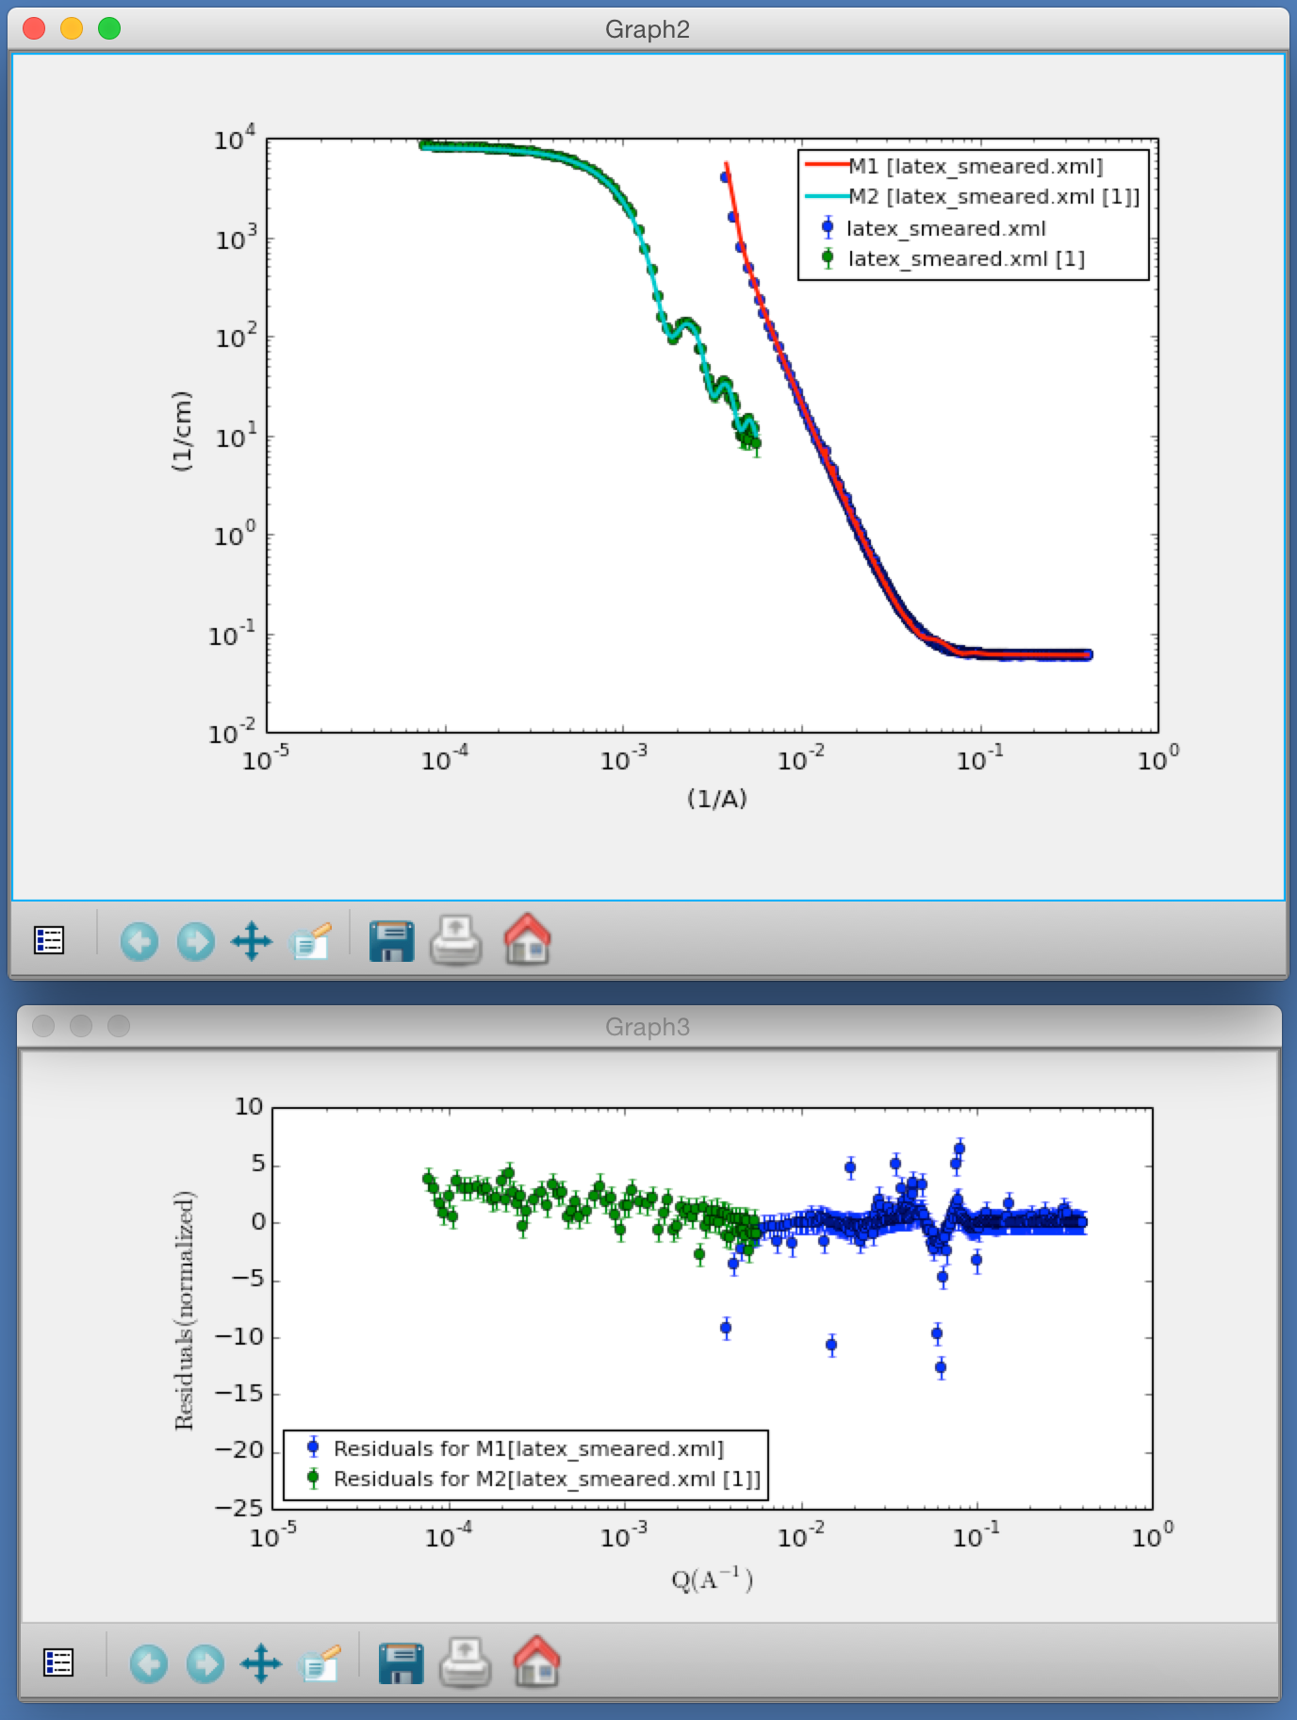
Constraints / Simultaneous Fit

Slide 24
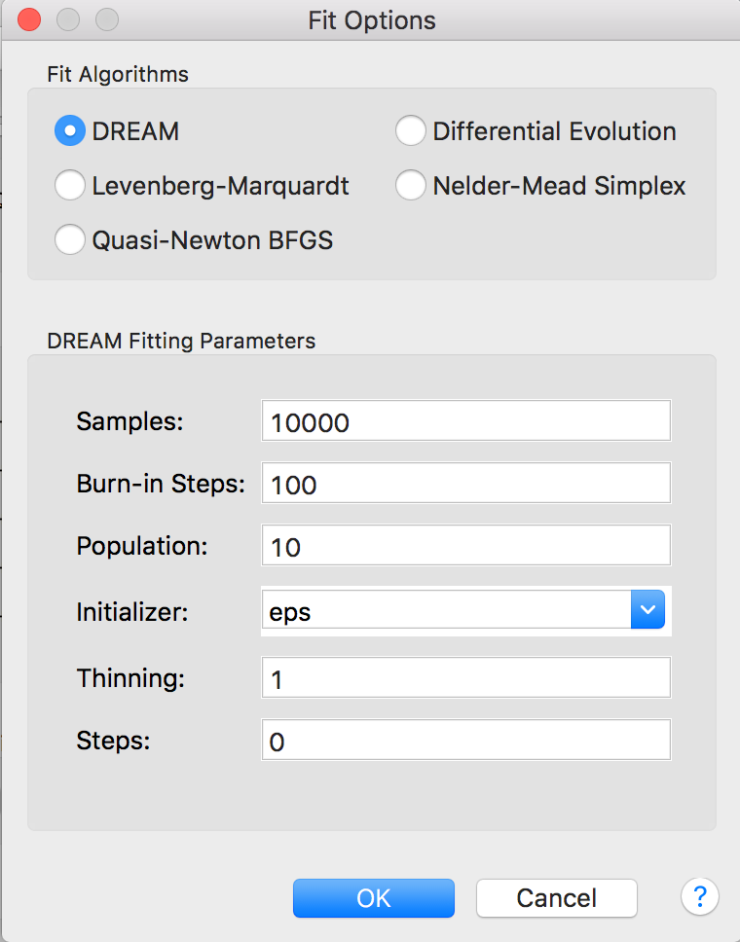
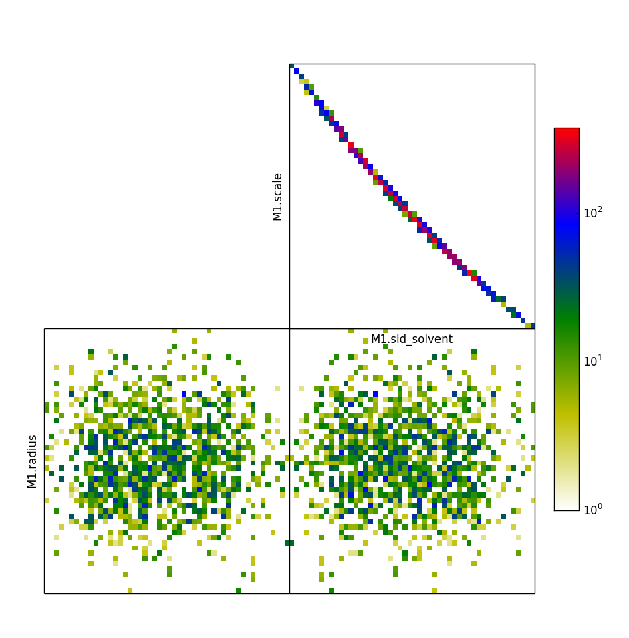
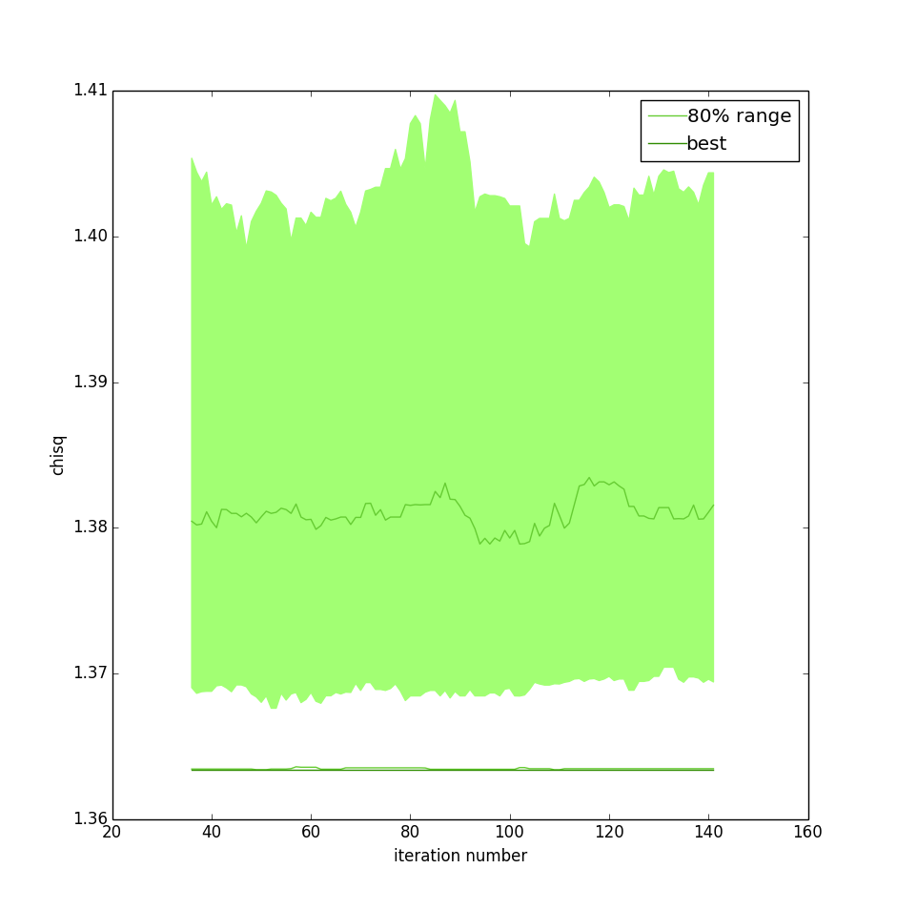
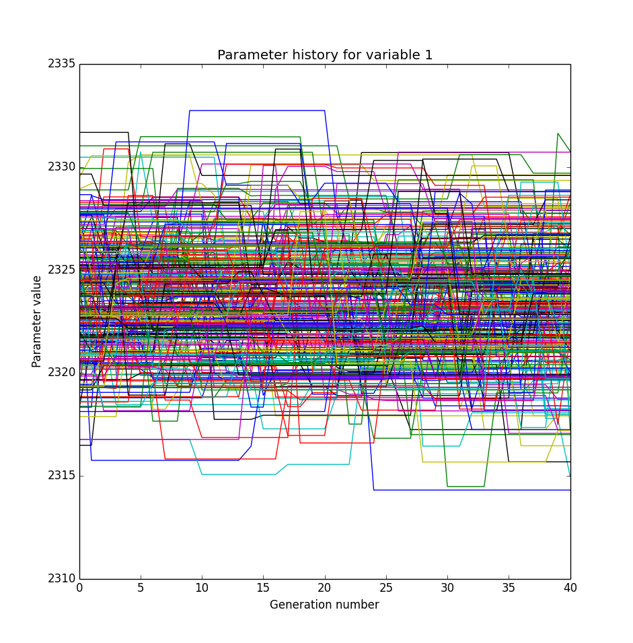
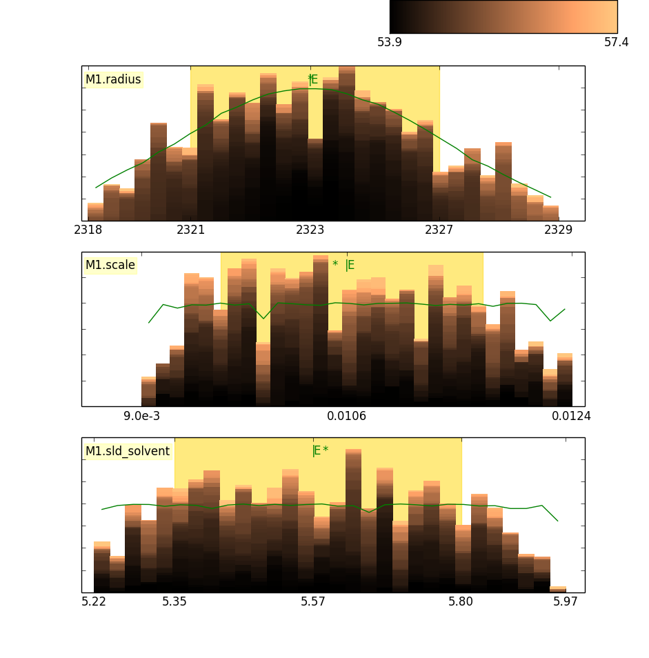
Fitting Algorithms

Slide 25
Fitting Algorithms

Slide 26
Fitting Algorithms

Slide 27
Fitting Algorithms

Slide 28
Fitting Algorithms

Slide 29
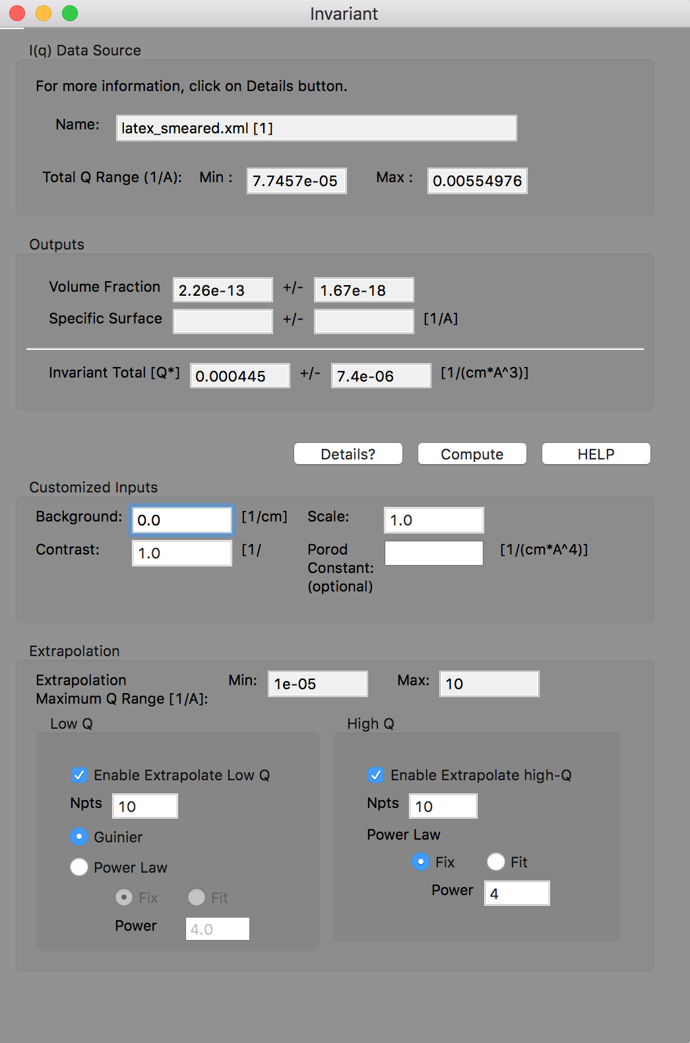
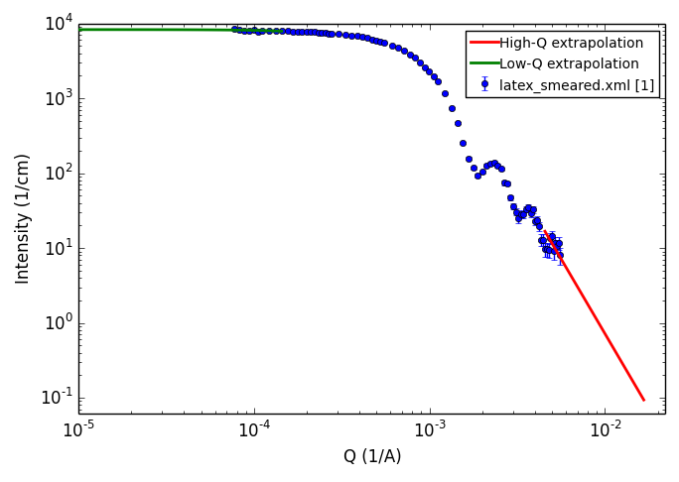
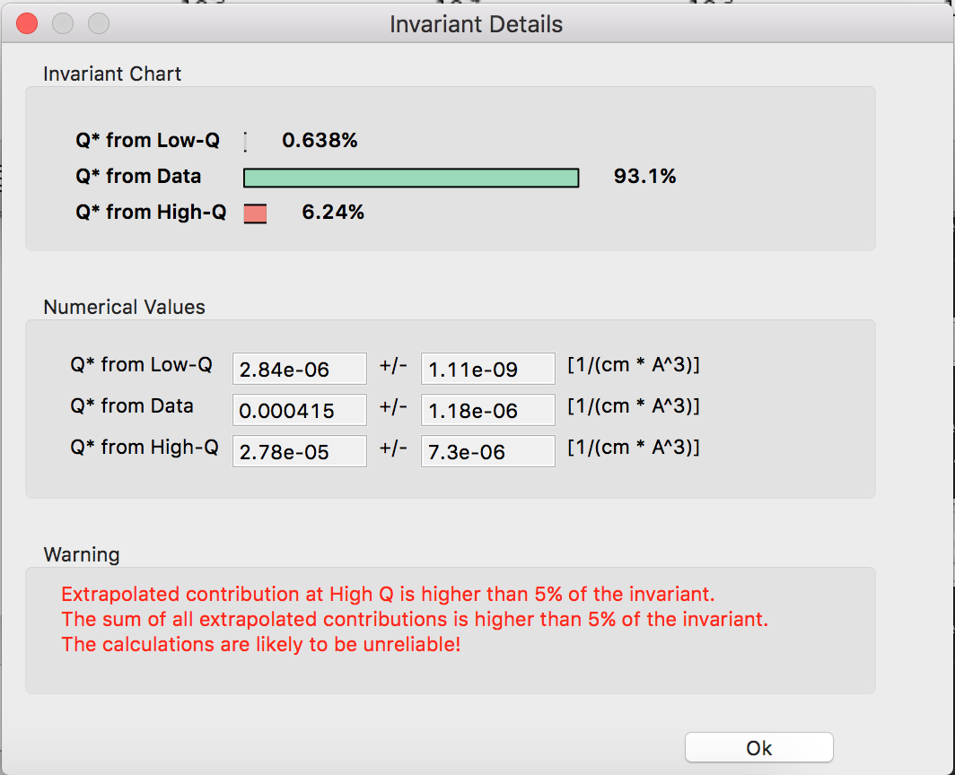
Invariant Calculation

Slide 30
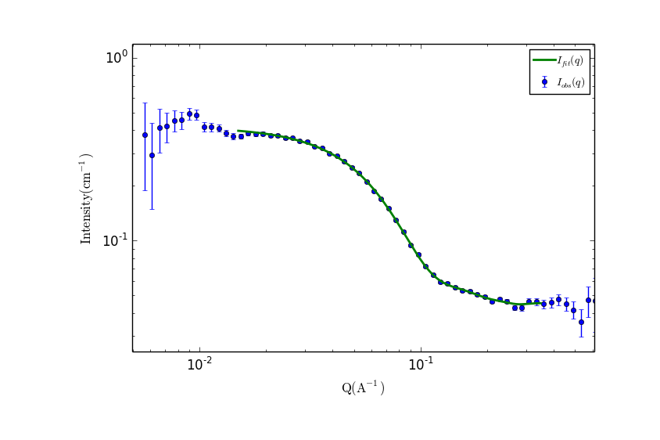
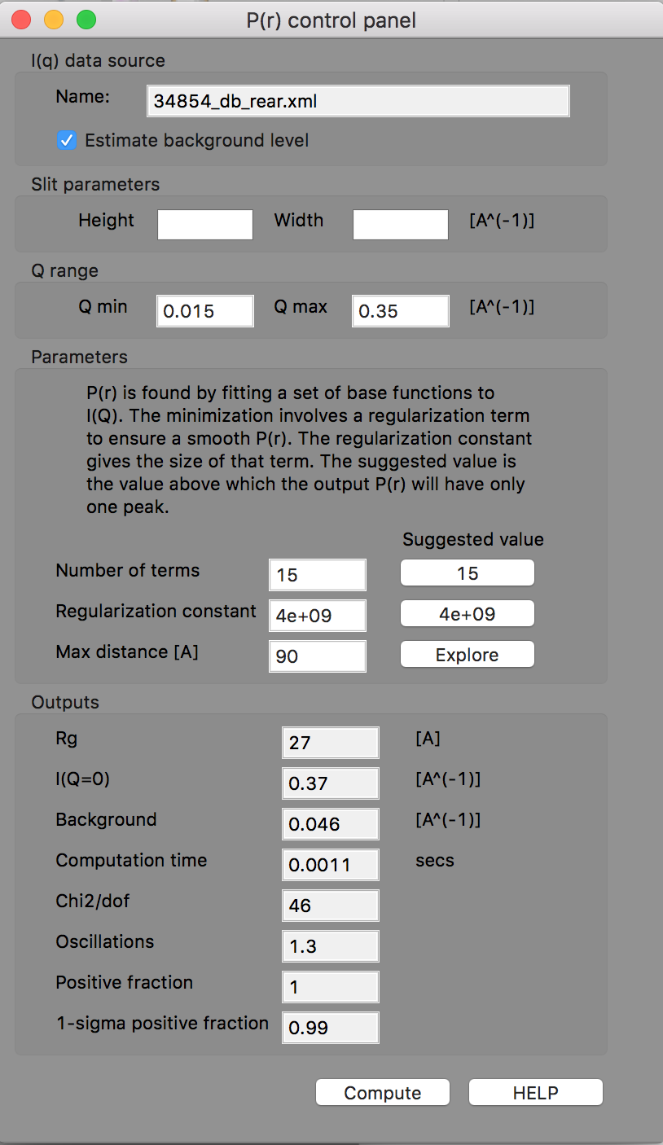
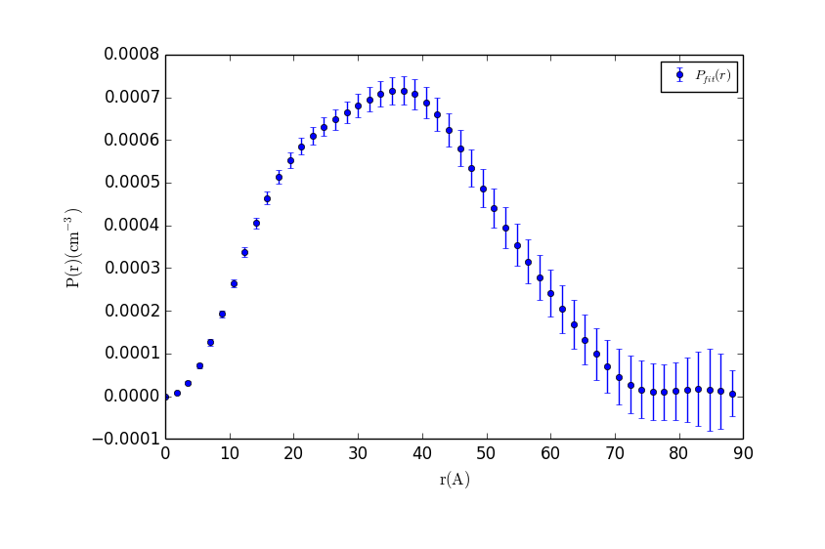
P(r) Inversion

Slide 31
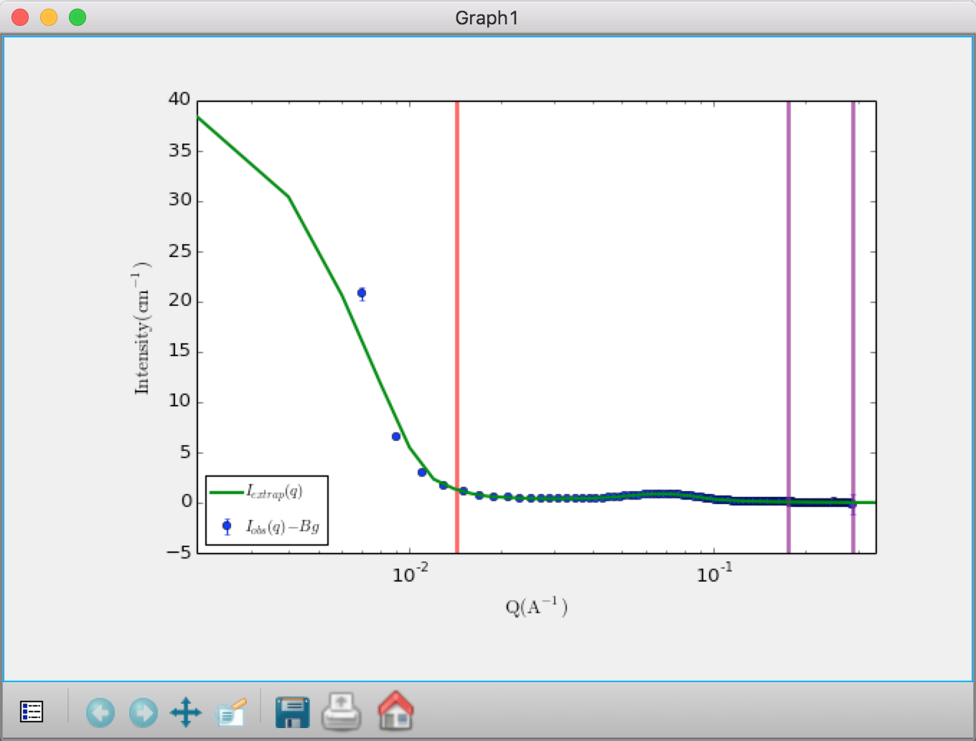
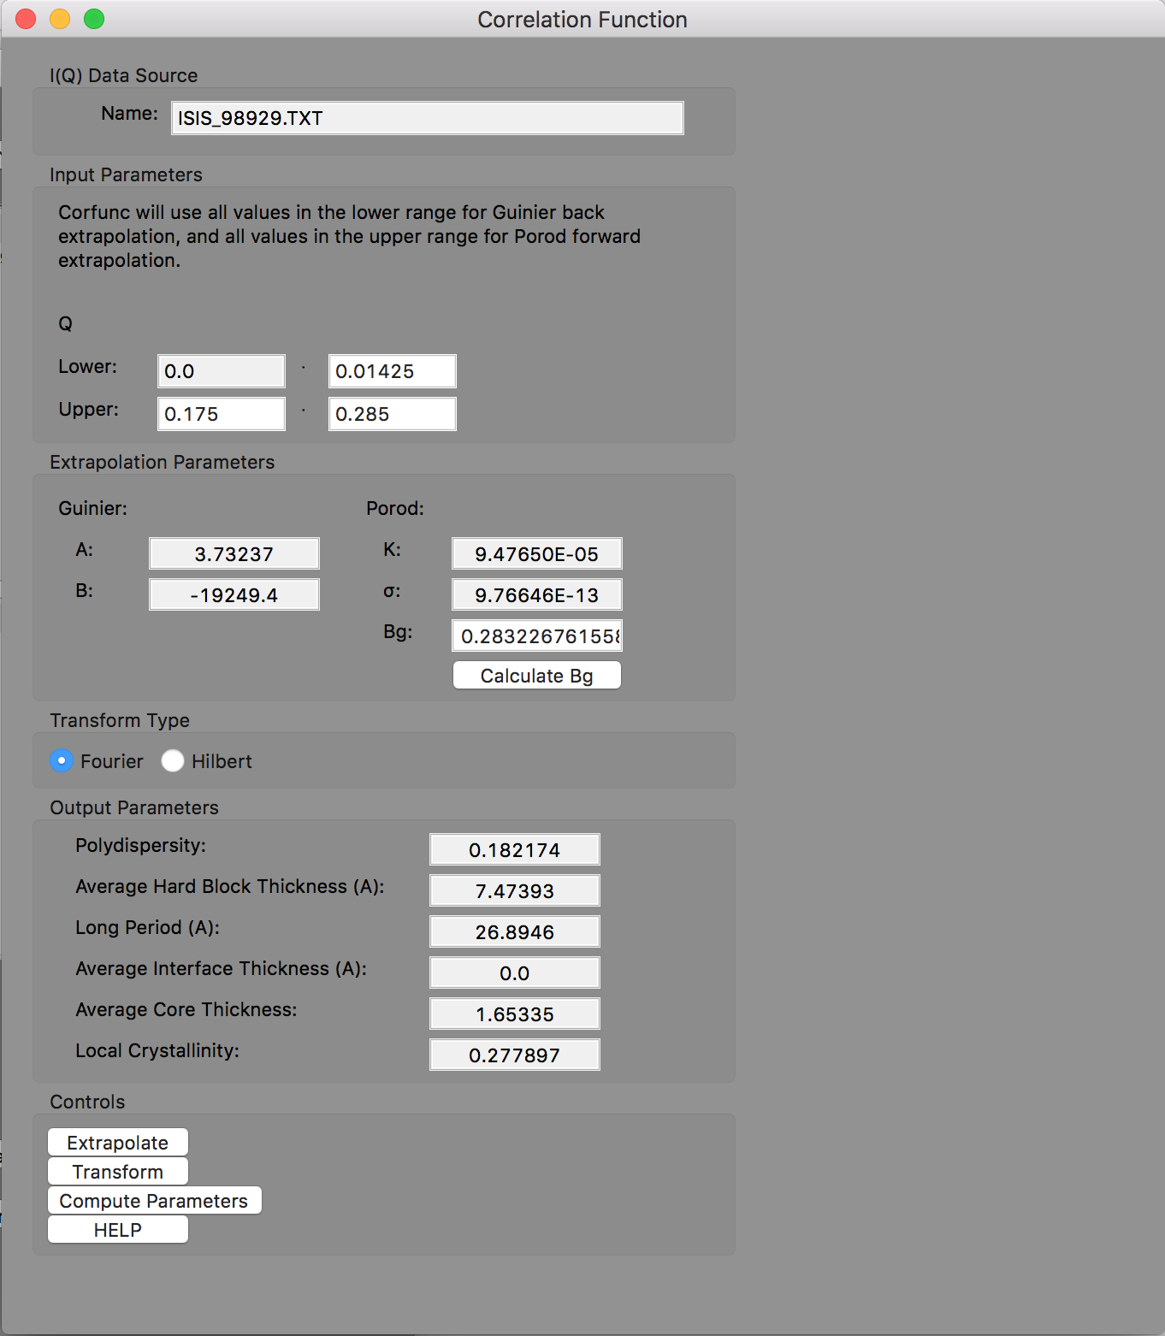
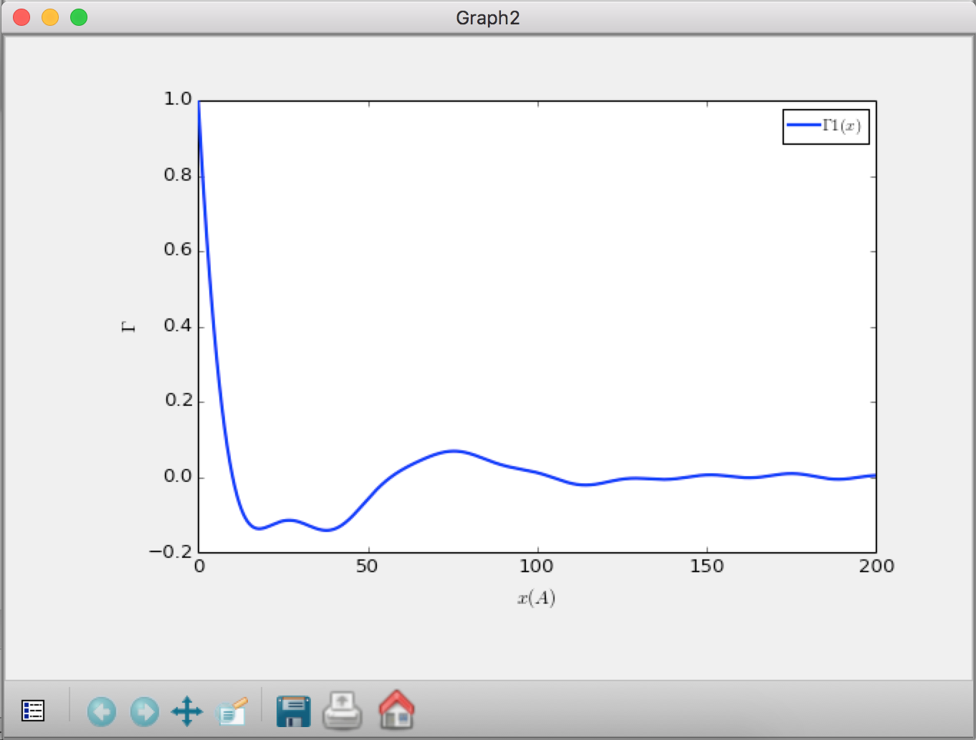
Correlation Function Analysis (new!)

Slide 32
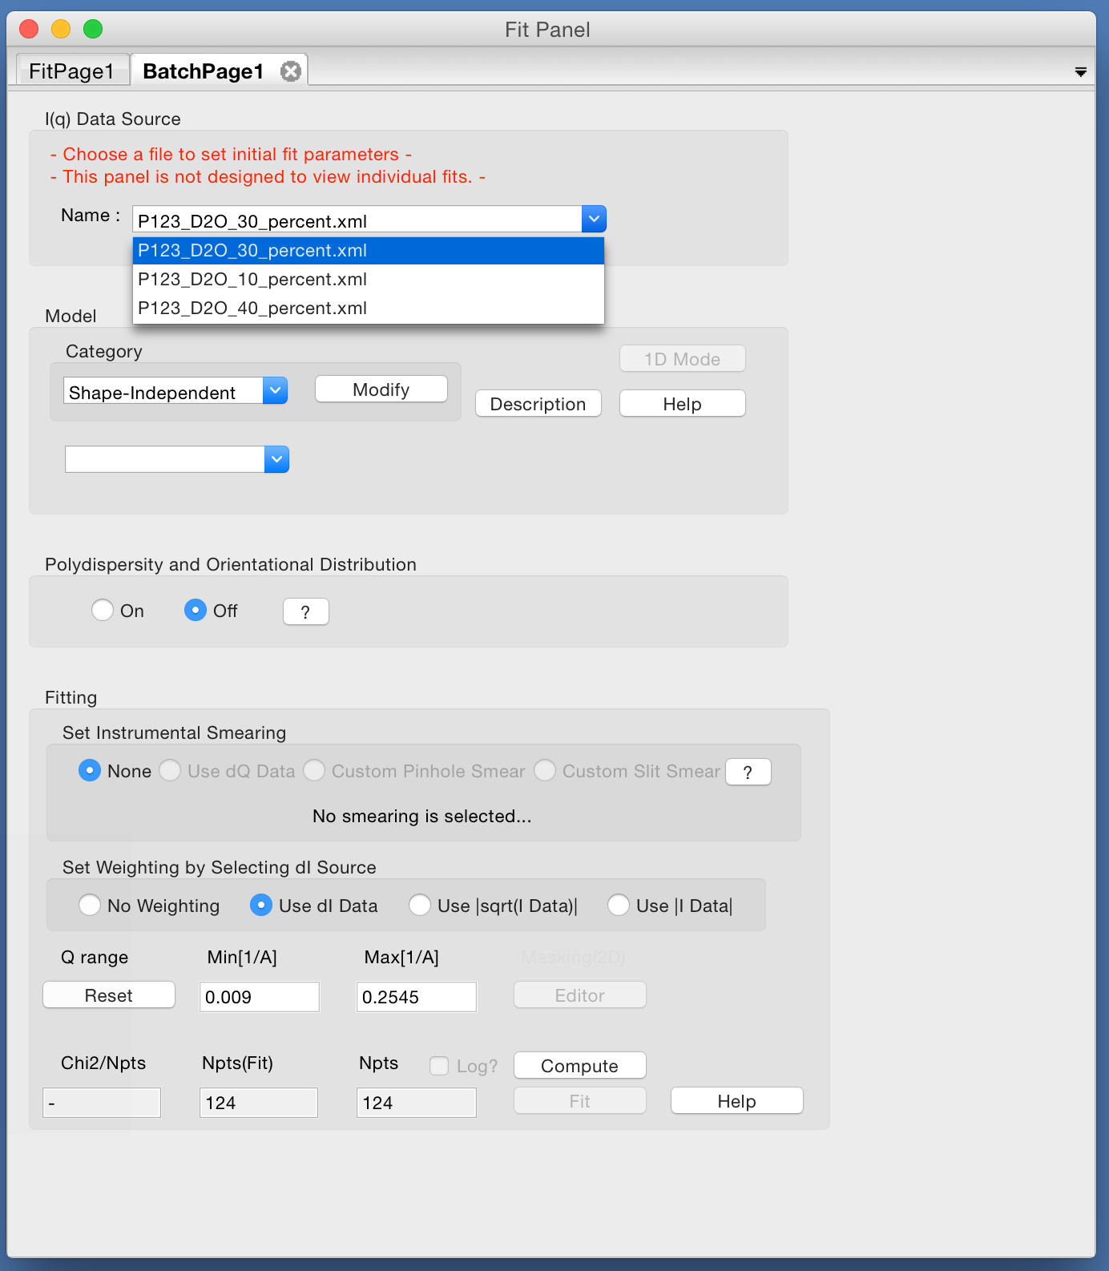
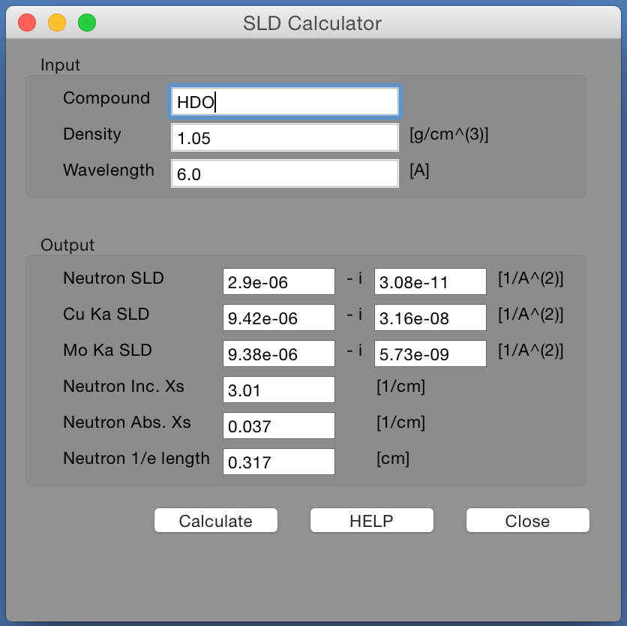
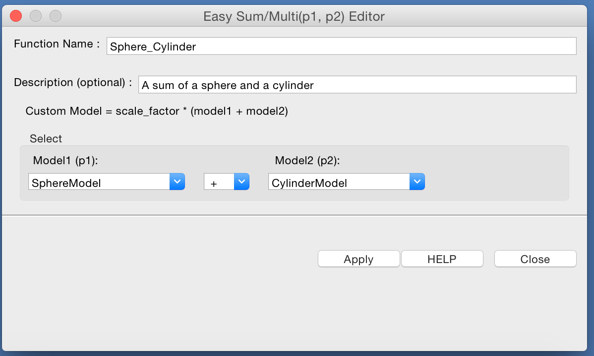
Other Features
Batch fitting …
SLD Calculator …
Sum & Multiplication of Models …

Slide 33
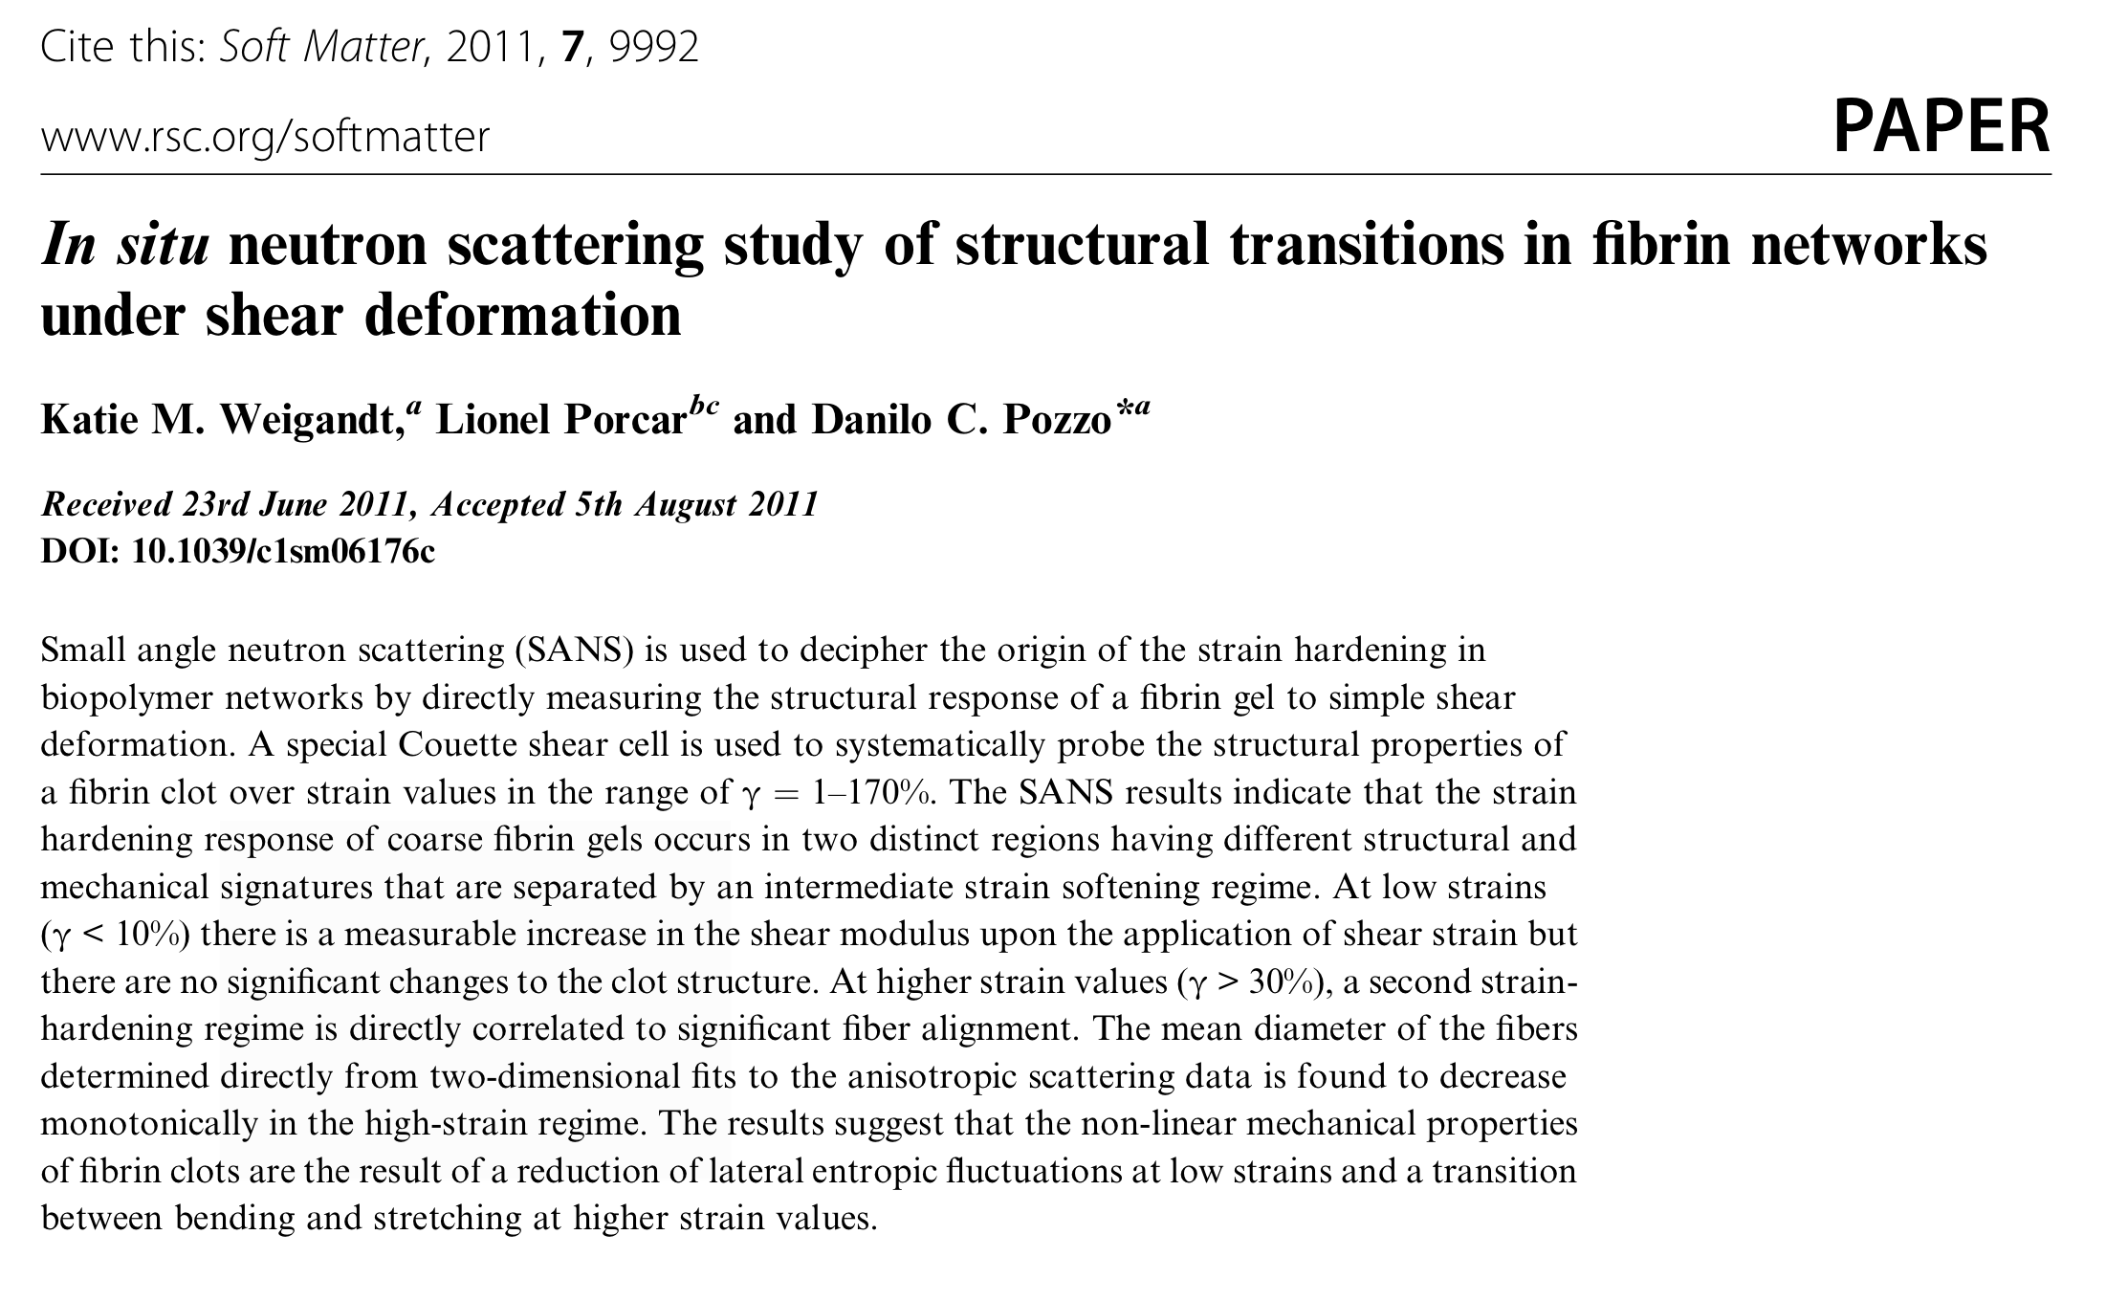
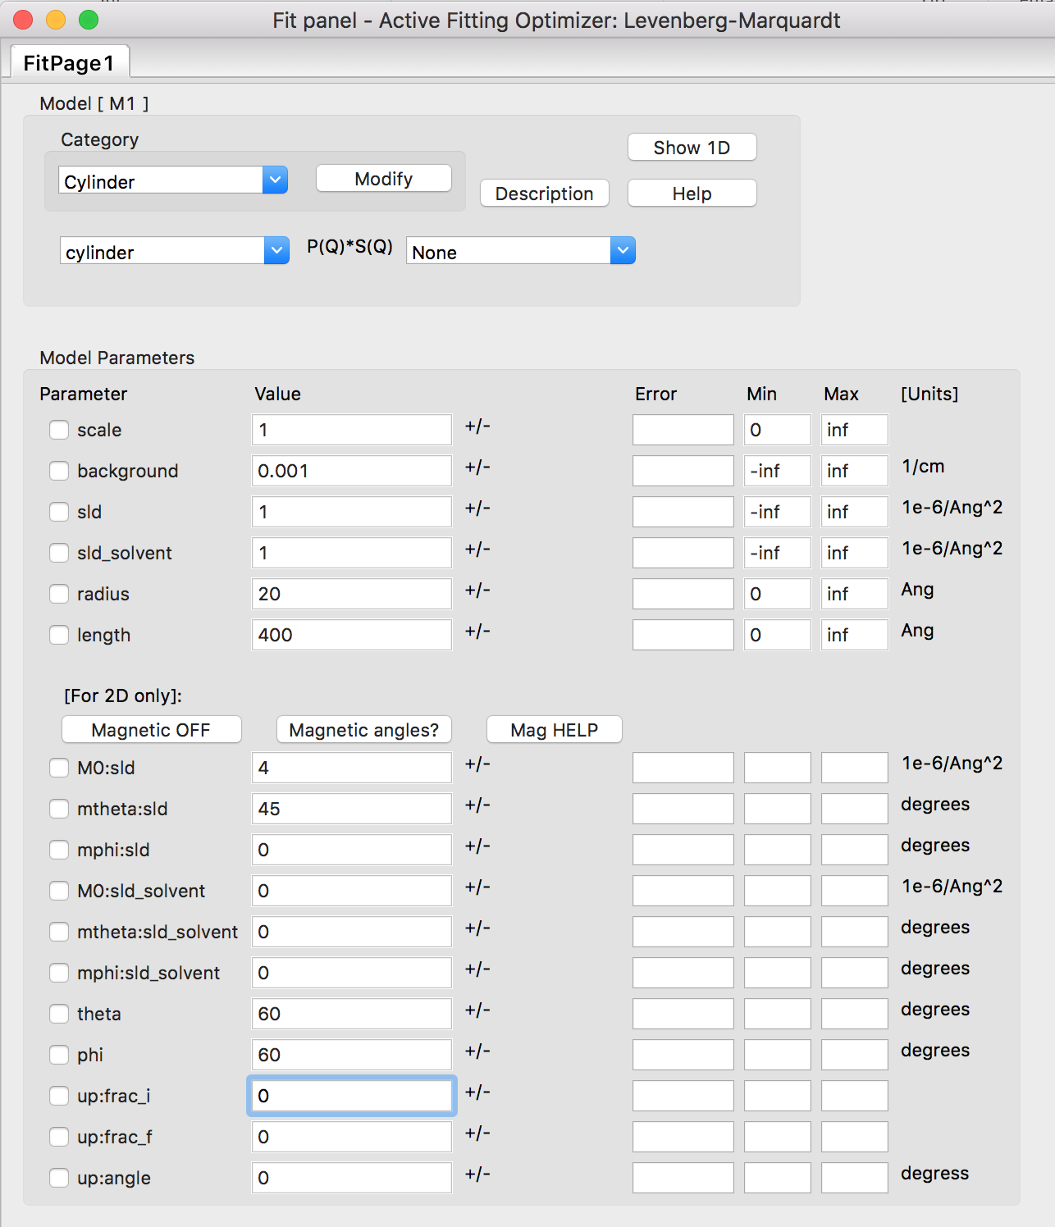
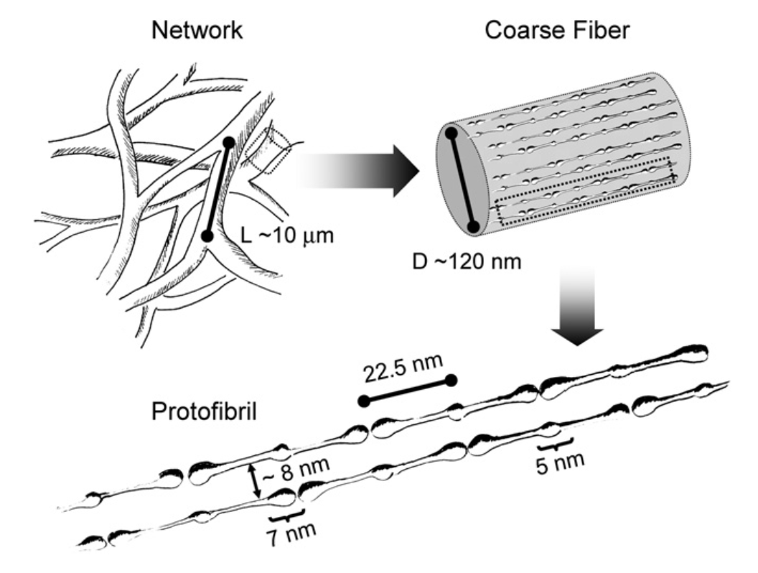
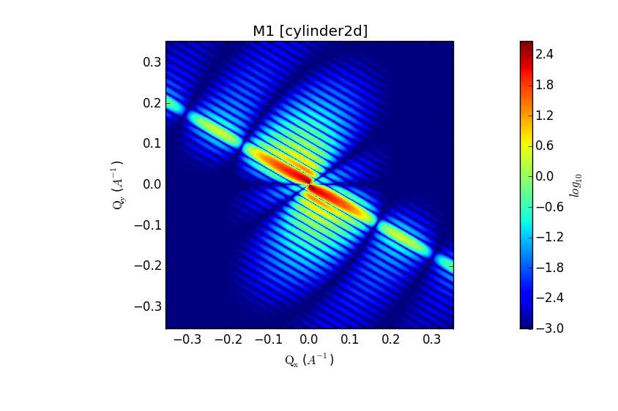
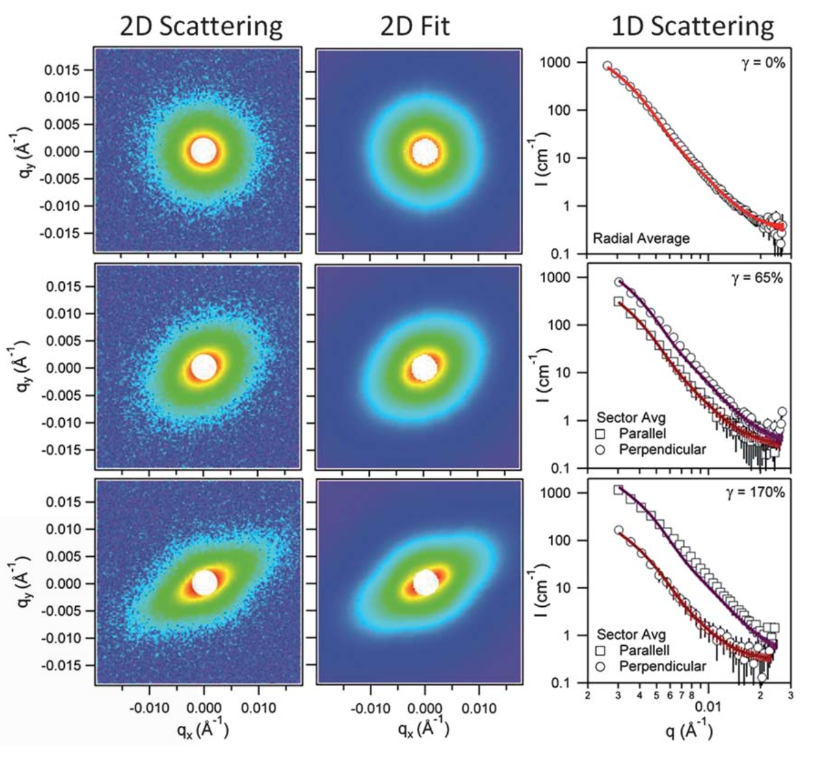
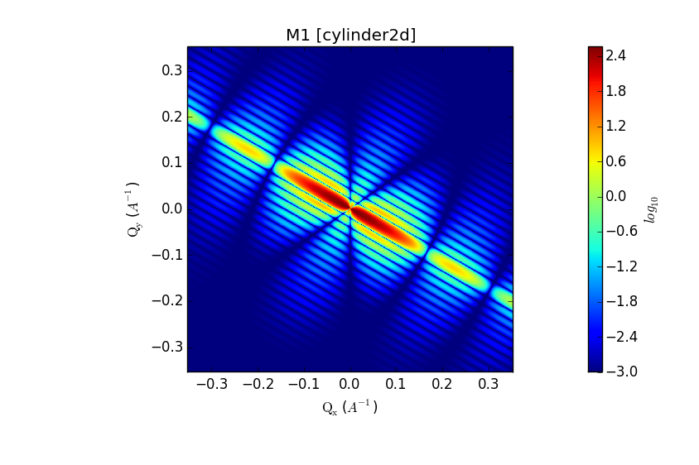
2D Modelling
Oriented systems & Magnetic Scattering
NSF
SF

Slide 34
Creating Models
Old Way
Write a model in python and drop it in plugin folder
Easy but no polydispersity available
Write a model in C and incorporate into SasView
Difficult and need to recompile whole programme
New Way
Models distributed in separate package (sasmodels)
separation of models from GUI
simpler addition of models by users
speed! GPU and parallel processing
All models work the same
Write in python and/or C and drop in plugin folder

Slide 35
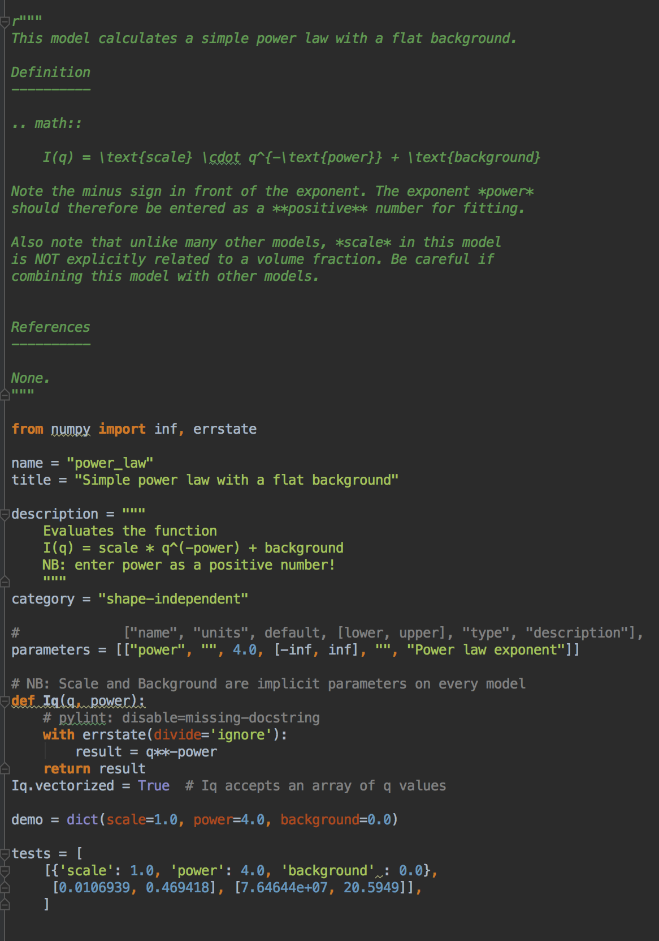
Creating Models
Pure Python
Documentation
Description
Parameters
Calculation
Tests

Slide 36
SasView 4.1 is Out!
www.sasview.org
Models
New models
New model package (sasmodels)
Separation of models from GUI
Simpler addition of models by users
Speed! GPU and parallel processing
Correlation Function Analysis
CCP13 corfunc algorithm
Documentation
Enhanced, updated documentation for models
SESANS
Automatic transform of SANS model to P(z)
Plotting and fitting of SESANS data from GUI
Example scripts for fitting SESANS data
Simultaneous fitting of SANS & SESANS

Slide 37
Future …
GUI Refactoring
Move to QT - current and well supported toolkit
Complete separation of GUI and calculation code
Non-desktop UIs
Sasmodels Enhancements
Return F(q) from models
Beta approximation
Coherent sums
Constraints refactor
Multi-GPU support
Interface for SasFit models
NSF
Documentation
Tutorials
Manual

Slide 38
Future …
And much more!
See Roadmap and Tickets
Contributions Needed
All skill sets welcome
Models
Testing
Core development
Documentation
Admin and Infrastructure
NSF

Slide 39
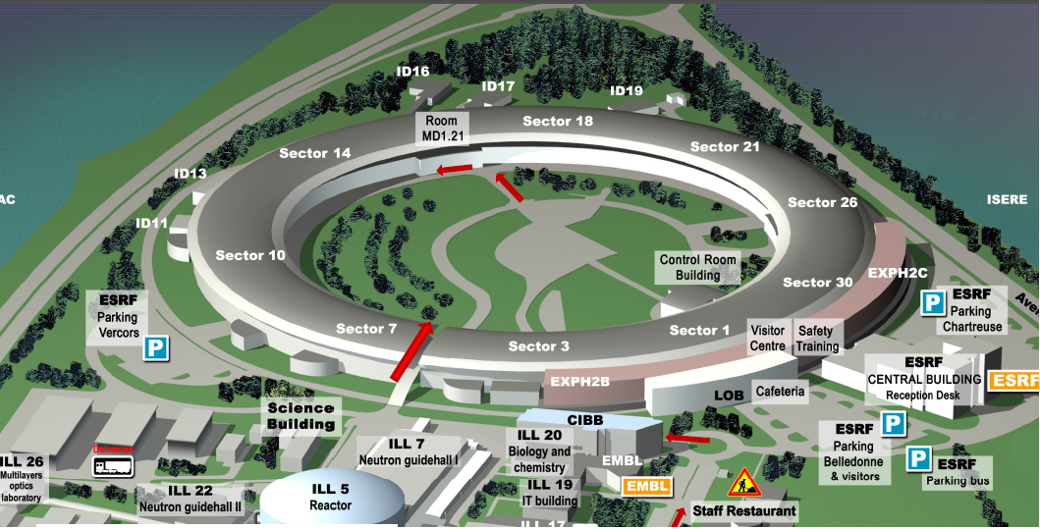
SasView code camp (http://trac.sasview.org/wiki/CodeCampVI)
Start on Tuesday 4th April at 9:00 at room MD-1-21 (ESRF)
Introduction for new contributors: 4th April at 13:00 (possibly at SB401)
Roadmap discussion: Friday 7th April at 15:30 (PSCM common room SB213?)
Until afternoon of Tuesday 11th April
Questions?

